Slide 1

CSE221: Algorithms
Max Sum Subarray
Prepared by: A B M Muntasir Rahman [MUNR]

Slide 2
Max Sum Subarray Problem
0 1 2 3 4 5 6 7 8 9 10 11 12 13 14 15
13 | -3 | -25 | 20 | -3 | -16 | -23 | 18 | 20 | -7 | 12 | -5 | -22 | 15 | -4 | 7
max sum subarray
Input: an array A[1..n] of n numbers
Assume that some of the numbers are negative, because this problem is trivial when all numbers are nonnegative
Output: a nonempty subarray A[i..j] having the largest sum S[i, j] = a_{i} + a_{i+1} +... + a_{j}

Slide 3
Max Sum Subarray Problem
3 | -2 | 5 | -1
Consider subarrays of size 1
Consider subarrays of size 2
Sum Max
Sum
Max
3
3
-2
1 | 5
3 | 5
4 | 5
3 | 3
-2 | 3
5 | 5
1 | 5
-2
-2
5
5
5
-1
-1

Slide 4
Max Sum Subarray Problem
3 | -2 | 5 | -1
Consider subarrays of size 3
Consider subarrays of size 4
Sum Max
Sum Max
3
-2
5
6 | 6
2 | 6
3
-2
5
-1
5 | 6
-2
5
-1
This is the brute force approach!

Slide 5
Brute Force Algorithm
Time complexity?
O(n²)
max = -∞
for i = 1 to n do
begin
sum = 0
for j = i to n do
begin
sum = sum + A[j]
if sum > max
then max = sum
end
end

Slide 6
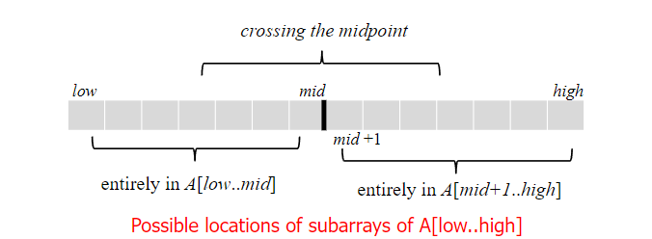
Divide & Conquer Approach
Possible locations of a maximum subarray A[i..j] of A[low..high],
where mid = (low + high)/2
entirely in A[low..mid] (low ≤ i ≤ j ≤ mid)
entirely in A[mid+1..high] (mid < i ≤ j ≤ high)
crossing the midpoint (low ≤ i ≤ mid < j ≤ high)

Slide 7
Divide & Conquer Approach
CSS = 6
3 | -2 | 5 | -1
LSS = 3
RSS = 5
CSS = 1
CSS = 4
3 | -2
5 | -1
LSS = 3
RSS = -2
LSS = 5
RSS = -1
3
-2
5
-1

Slide 8
Pseudocode
maxSumSubArray(arr, n)
if n == 1
return arr[0]
mid = n//2
leftSum = maxSumSubArray(arr[:mid], mid)
rightSum = maxSumSubArray(arr[mid:], n - mid)
crossLeft, crossRight, sum = float('-inf'), float('-inf'), 0
for i = mid - 1 to 0
sum = sum + arr[i]
crossLeft = max(crossLeft, sum)
sum = 0
for j = mid to n - 1
sum = sum + arr[j]
crossRight = max(crossRight, sum)
crossSum = crossLeft + crossRight
return max(leftSum, rightSum, crossSum)

Slide 9
Time Complexity Analysis
maxSumSubArray(arr, n)
if n == 1
return arr[0]
mid = n//2
leftSum = maxSumSubArray(arr[:mid], mid) T(n/2)
rightSum = maxSumSubArray(arr[mid:], n - mid) T(n/2)
crossLeft, crossRight, sum = float('-inf'), float('-inf'), 0
for i = mid - 1 to 0 n/2
sum = sum + arr[i]
crossLeft = max(crossLeft, sum)
sum = 0
for j = mid to n - 1 n/2
sum = sum + arr[j]
crossRight = max(crossRight, sum)
crossSum = crossLeft + crossRight
return max(leftSum, rightSum, crossSum)

Slide 10
Time Complexity Analysis
Therefore,
T(n) = 2T(n/2) + n/2 + n/2 = 2T(n/2) + O(n)
Applying Master’s theorem,
a = 2, b^{k} = 2 and p = 0, therefore a = b^{k} and p > -1
T(n) = O(n^(log_{b}a) log^{p+1}n) = O(n^(log₂2) log⁰⁺¹n) = O(nlogn)

